Slide 1


Corona virus Analysis
By SQL
By : Chandni verma
Batch Name: MIP-DA-11

Slide 2

Project overview
The CORONA VIRUS pandemic has had a significant impact on public health and has created an urgent
need for data-driven insights to understand the spread of the virus. As a data analyst, you have been
tasked with analyzing a CORONA VIRUS dataset to derive meaningful insights and present your findings.
The analysis of the available corona virus data aim to drive meaningful insight from the spread and demographic impact of the virus by SQL query

Slide 3
Datasets:
Province: Geographic subdivision within a
Country/Region: Geographic entity where data is recorded.
Latitude: North-south position on Earth's surface.
Longitude: East-west position on Earth's surface.
Date: Recorded date of CORONA VIRUS data.
Confirmed: Number of diagnosed CORONA VIRUS cases.
Deaths: Number of CORONA VIRUS related deaths.
Recovered: Number of recovered CORONA VIRUS cases.

Slide 4
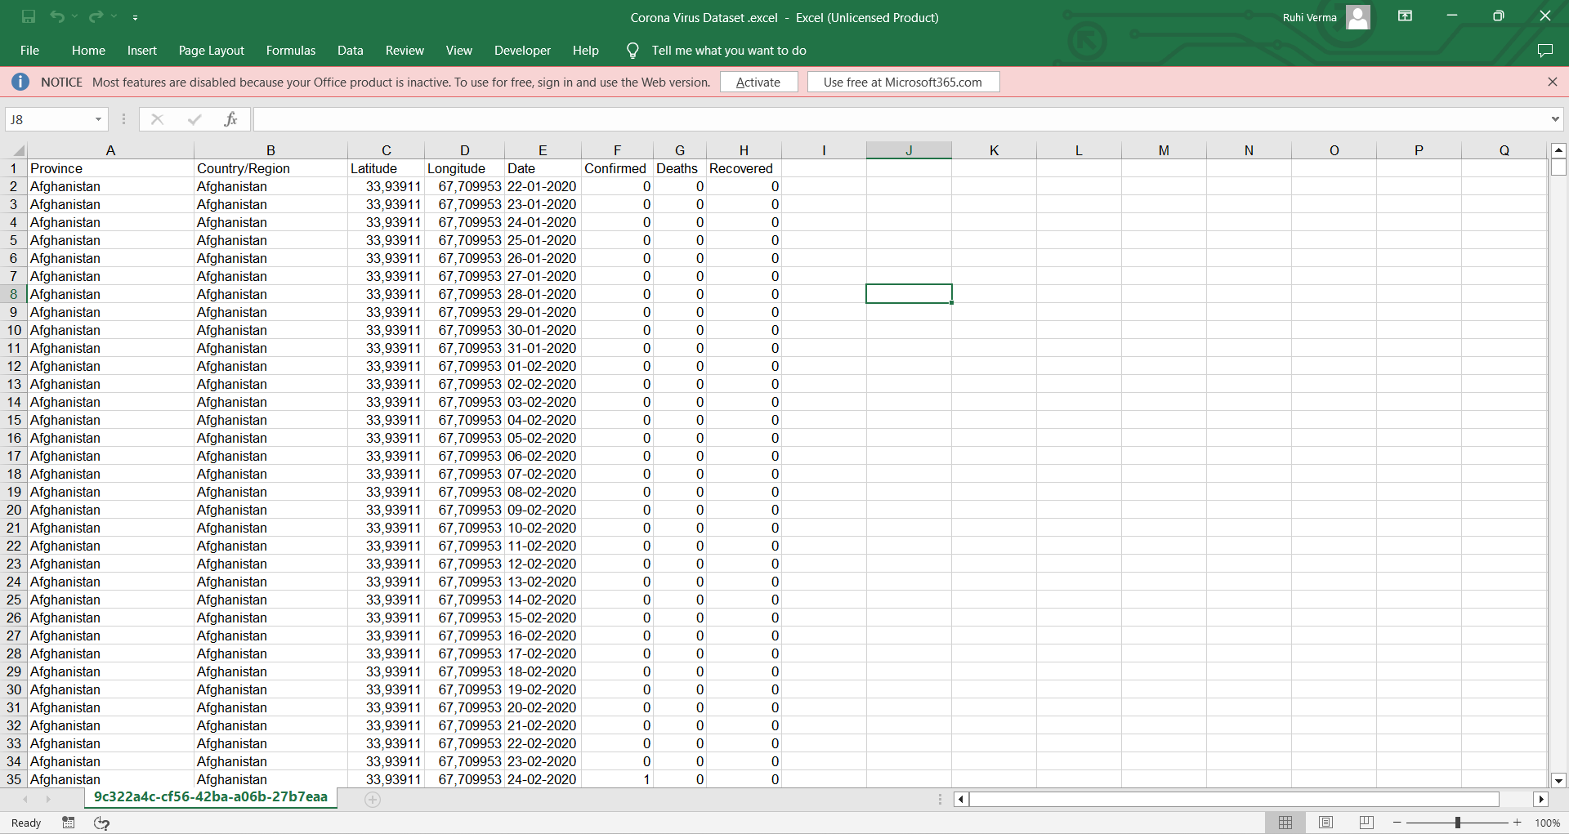

Slide 5
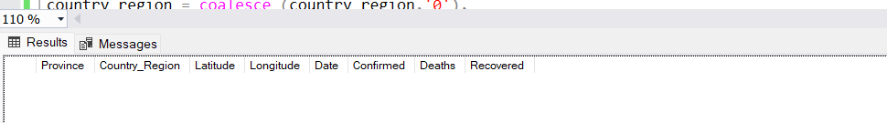
Q1. Write a code to check NULL values
output
SELECT *
FROM [dbo].[Corona Virus]
WHERE
Province is null or country_region is null or
Latitude IS NULL OR Longitude IS NULL or
date is null or confirmed is null
or deaths is null or recovered is null;

Slide 6
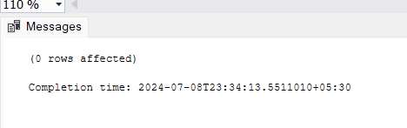
Q2. If NULL values are present, update them with zeros for all columns.
output
update [dbo].[Corona Virus ]
set
province = coalesce (province,'0'),
country_region = coalesce (country_region,'0'),
latitude = coalesce (latitude,'0'),
longitude = coalesce (longitude,'0'),
date = coalesce (date,'0'),
confirmed = coalesce (confirmed,'0'),
deaths = coalesce (deaths,'0'),
recovered = coalesce (recovered,'0')
WHERE
province IS NULL OR country_region IS NULL OR latitude IS NULL OR
longitude IS NULL OR date IS NULL OR confirmed IS NULL OR
deaths IS NULL OR recovered IS NULL;

Slide 7
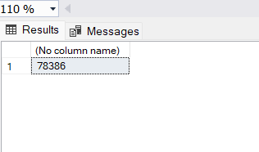
Q3. check total number of rows
Output
select count (*)from [dbo].[Corona Virus];

Slide 8
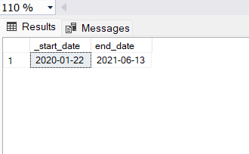
Q4. Check what is start_date and end_date
Finding the earliest (start date) and latest (end date) dates in a single table
SELECT
MIN(date) AS _start_date,
MAX(date) AS end_date
FROM [dbo].[Corona Virus];
Output

Slide 9
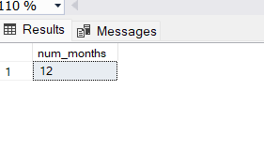
Q5. Number of month present in dataset
Output
SELECT COUNT(DISTINCT MONTH(date)) AS num_months
FROM [dbo].[Corona Virus];

Slide 10
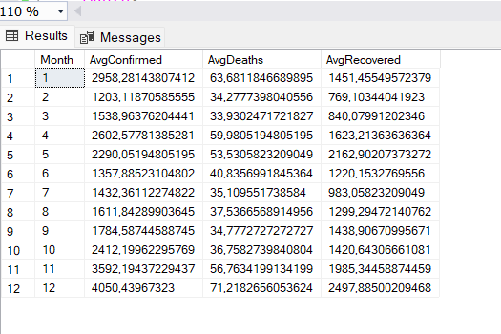
Q6. Find monthly average for confirmed, deaths, recovered
Output
SELECT
MONTH(date) AS Month,
AVG(CAST(confirmed AS FLOAT)) AS AvgConfirmed,
AVG(CAST(deaths AS FLOAT)) AS AvgDeaths,
AVG(CAST(recovered AS FLOAT)) AS AvgRecovered
FROM [dbo].[Corona Virus]
GROUP BY MONTH(date)
ORDER BY Month;

Slide 11
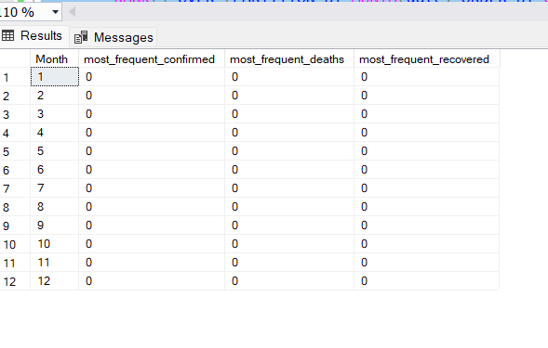
Q7. Find most frequent value for confirmed, deaths, recovered each month
Output
SELECT
Month,
MAX(CASE WHEN rn_confirmed = 1 THEN confirmed END) AS most_frequent_confirmed,
MAX(CASE WHEN rn_deaths = 1 THEN deaths END) AS most_frequent_deaths,
MAX(CASE WHEN rn_recovered = 1 THEN recovered END) AS most_frequent_recovered
FROM (
SELECT
MONTH(date) AS Month,
confirmed,
deaths,
recovered,
RANK() OVER (PARTITION BY MONTH(date) ORDER BY COUNT(*) DESC) AS rn_confirmed,
RANK() OVER (PARTITION BY MONTH(date) ORDER BY COUNT(*) DESC) AS rn_deaths,
RANK() OVER (PARTITION BY MONTH(date) ORDER BY COUNT(*) DESC) AS rn_recovered
FROM [dbo].[Corona Virus]
GROUP BY MONTH(date), confirmed, deaths, recovered
) AS RankedData
WHERE rn_confirmed = 1 OR rn_deaths = 1 OR rn_recovered = 1
GROUP BY Month
ORDER BY Month;

Slide 12
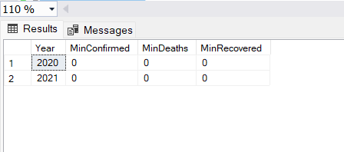
Q8. Find minimum values for confirmed, deaths, recovered per year
SELECT
YEAR(date) AS Year,
MIN(confirmed) AS MinConfirmed,
MIN(deaths) AS MinDeaths,
MIN(recovered) AS MinRecovered
FROM [dbo].[Corona Virus]
GROUP BY YEAR(date)
ORDER BY Year;
Output

Slide 13
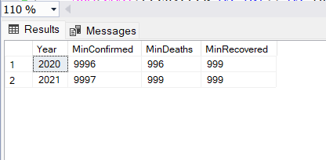
Q9. Find maximum values of confirmed, deaths, recovered per year
SELECT
YEAR(date) AS Year,
MAX(confirmed) AS MinConfirmed,
MAX(deaths) AS MinDeaths,
MAX(recovered) AS MinRecovered
FROM [dbo].[Corona Virus]
GROUP BY YEAR(date)
ORDER BY Year;
Output

Slide 14
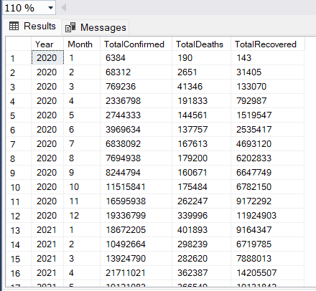
Q10. The total number of case of confirmed, deaths, recovered each month
Output
SELECT
YEAR(date) AS Year,
MONTH(date) AS Month,
SUM(CAST(confirmed AS INT)) AS TotalConfirmed,
SUM(CAST(deaths AS INT)) AS TotalDeaths,
SUM(CAST(recovered AS INT)) AS TotalRecovered
FROM [dbo].[Corona Virus]
GROUP BY YEAR(date), MONTH(date)
ORDER BY Year, Month;

Slide 15
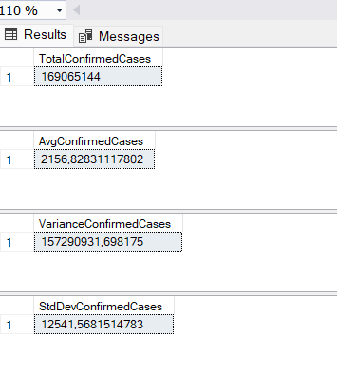
Q11. Check how corona virus spread out with respect to confirmed case
(Eg.: total confirmed cases, their average, variance & STDEV )
SELECT
SUM(cast(confirmed as int)) AS TotalConfirmedCases
FROM [dbo].[Corona Virus];
SELECT
avg(cast(confirmed as float)) AS AvgConfirmedCases
FROM [dbo].[Corona Virus];
SELECT
VAR(cast(confirmed as int)) AS VarianceConfirmedCases
FROM [dbo].[Corona Virus];
SELECT
STDEV(cast(confirmed as int)) AS StdDevConfirmedCases
FROM [dbo].[Corona Virus];
Output

Slide 16
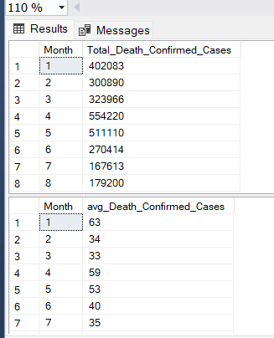
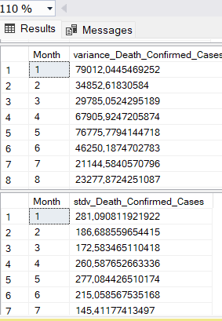
Q12. Check how corona virus spread out with respect to death case per month (Eg.: total confirmed cases, their average, variance & STDEV )
Output
SELECT
MONTH(date) AS Month,
SUM(CAST(deaths AS INT)) AS Total_Death_Confirmed_Cases
FROM [dbo].[Corona Virus]
GROUP BY MONTH(date)
ORDER BY Month;
SELECT
MONTH(date) AS Month,
avg(CAST(deaths AS INT)) AS avg_Death_Confirmed_Cases
FROM [dbo].[Corona Virus]
GROUP BY MONTH(date)
ORDER BY Month;
SELECT
MONTH(date) AS Month,
var(cast(deaths as int)) AS variance_Death_Confirmed_Cases
FROM [dbo].[Corona Virus]
GROUP BY MONTH(date)
ORDER BY Month;
SELECT
MONTH(date) AS Month,
stdev(cast(deaths as int)) AS stdv_Death_Confirmed_Cases
FROM [dbo].[Corona Virus]
GROUP BY MONTH(date)
ORDER BY Month;

Slide 17
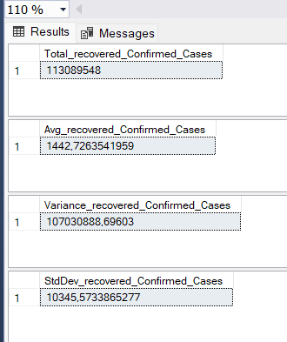
Q13. Check how corona virus spread out with respect to recovered case(Eg.: total confirmed cases, their average, variance & STDEV )
Output
SELECT
SUM(cast(recovered as int)) AS Total_recovered_Confirmed_Cases
FROM [dbo].[Corona Virus];
SELECT
avg(cast(recovered as float)) AS Avg_recovered_Confirmed_Cases
FROM [dbo].[Corona Virus];
SELECT
VAR(cast(recovered as int)) AS Variance_recovered_Confirmed_Cases
FROM [dbo].[Corona Virus];
SELECT
STDEV(cast(recovered as int)) AS StdDev_recovered_Confirmed_Cases
FROM [dbo].[Corona Virus];

Slide 18
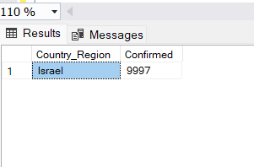
Q14. Find Country having highest number of the Confirmed case
Output
SELECT TOP 1 Country_Region, Confirmed
FROM [dbo].[Corona Virus ]
ORDER BY Confirmed DESC;

Slide 19
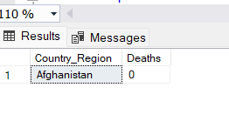
Q15. Find Country having lowest number of the death case
Output
SELECT TOP 1 Country_Region, Deaths
FROM [dbo].[Corona Virus ]
ORDER BY Deaths ASC;

Slide 20
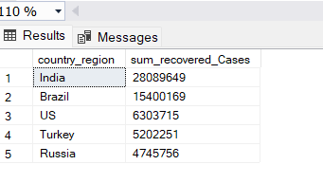
Q16. Find top 5 countries having highest recovered case
SELECT top 5
country_region,
sum(cast(recovered as int)) AS sum_recovered_Cases
FROM [dbo].[Corona Virus]
GROUP BY Country_region
ORDER BY sum_recovered_Cases DESC;
Output

Slide 21
Insights
The dataset cover the date 2020-01-22 to 2021-06-13, encompassing 18 month of data on confirmed ,deaths and recoveries cases
Having total 78386 number row in the given data
Average confirmed=2958,28143807412 , average deaths=63,6811846689895 and average recovered cases = 1451,145549572379
Minimum death cases are present in the year 2020
Israel having highest number of confirm cases
Lowest number of death cases are present in Afghanistan
India has a highest number of recovered cases

Slide 22
!!Thank you !!

